Slide 1
50 Joer HP-65 Deen éischten programméierbaren wëssenschaftlechen Taschenrechner huet Gebuertsdag
Claude Baumann Francis Massen
Computarium LCD
claude.baumann@education.lu
francis.massen@education.lu
https://computarium.lcd.lu

Slide 2
Overview
HP-35, éischten wëssenschaftlechen TR (1972) Entwécklong, Technik, RPN [Francis]
HP-65 = programméierbaren HP-35 (1974) Wat ass nei, Technik, Magneitkaartenlieser, Programmatioun [Claude]
Restauration fum HP-65 Watt a wei muss gefléckt gin…[Claude + Francis]
Lilli-Python-Crosscompiler fir den HP-65 Eng nei an original Entwécklong…[Claude]
Emulators, Links an weider Infos …[Claude + Francis]
Notes:
Will be changed and written in English…

Slide 3
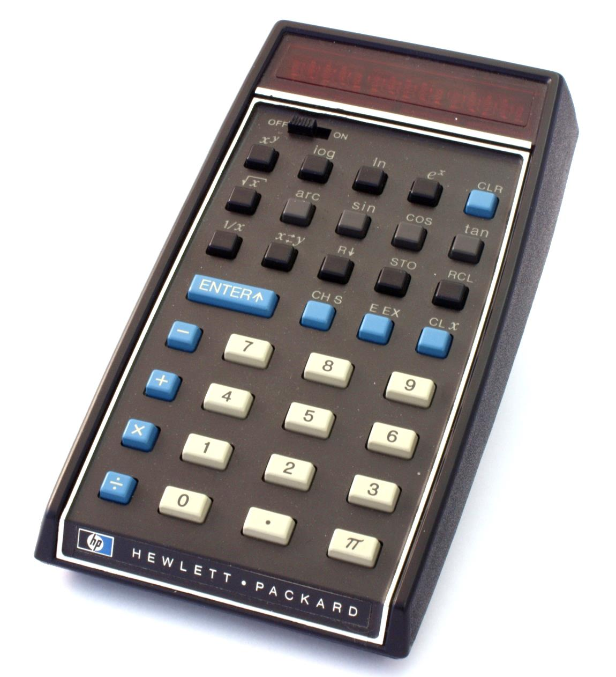
HP-35
HP-35 of Jean MOOTZ (+)
Computarium Collection

Slide 4
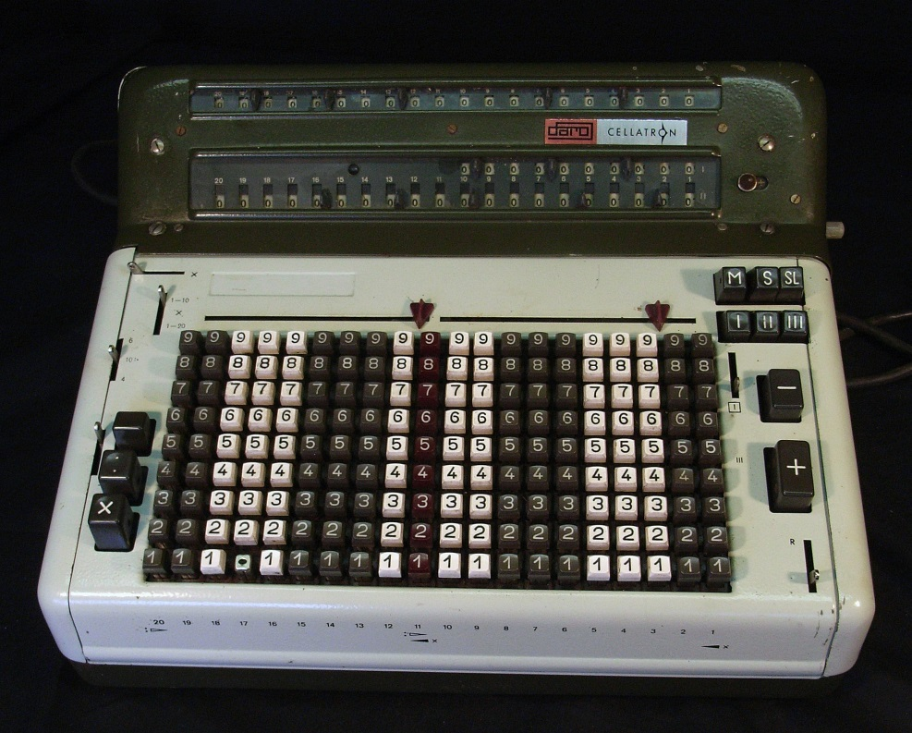
HP-35/ 01
This is a typical fully automatically 4 function electro-mechanical desktop calculator, built up to 1968: MERCEDES-EUKLID R44SM, DDR:
Calculators of this type were used at the start of the Manhattan project, and were the standard calculators in the universities and research labs.

Slide 5
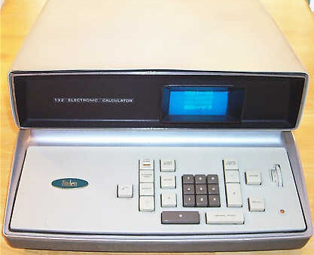
HP-35/ 02
Friden EC-130, 1964, USA:
The first all-electronic solid-state desktop calculator. No IC’s, only transistors, delay-line cache memory. Four functions, square-root, but no scientific functions!

Slide 6
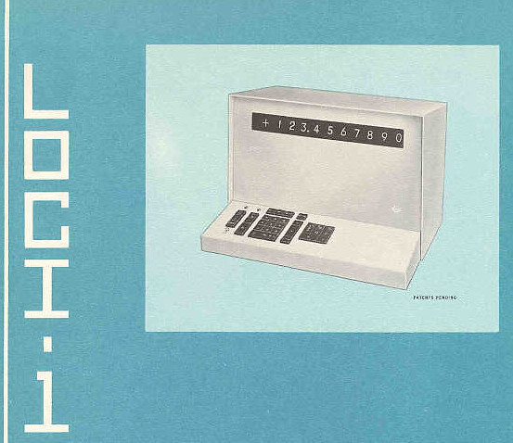
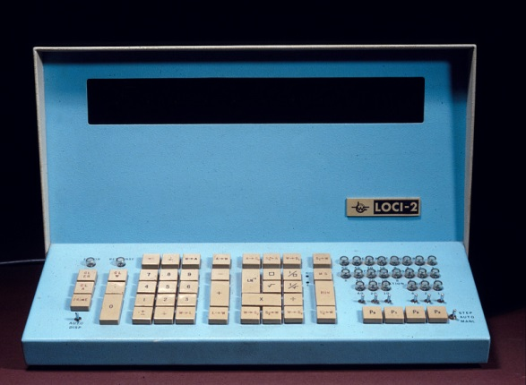
HP-35/ 03
First “semi-scientific” electronic desktop calculator: WANG LOCI-1,1964: USA. LOCI means Logarithmic Calculating Instrument
Designed by An Wang, display = 1 row of Nixie tubes, not programmable. The follower LOCI-2 (1965, right picture) was programmable. New and original algorithm to calculate logarithms.
The follower WANG 320S (1968) could compute trig. functions by program (not specific keys)

Slide 7
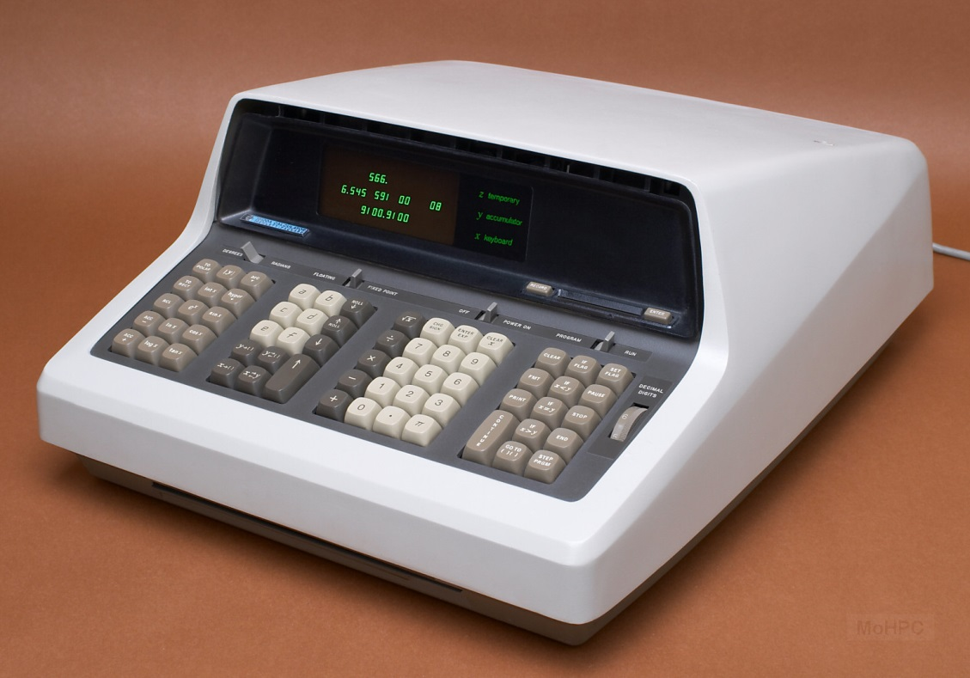
HP-35/ 04
First scientific (and programmable) desktop calculator by HP, HP 9100, USA, 1968:
Designed by Malcom McMillan and Tom Osborne: RPN, X,Y, Z stacks.
Discrete circuitry (no IC’s), core memory.

Slide 8
HP-35/ 05
Bill Hewlett (one of the founders of Hewlett-Packard), 1971:
I want a scientific calculator with the functions of the 9100, but:
10 times faster
10 times smaller
10 times lower cost
Tom Osborne, Dave Cochran et al. started the design of a non-programmable
hand-held in 1971, and only 1 year later the calculator went into production! 100 000 sold in first year! The Stanford Research Institute had predicted that there was no market for such a device and development should be abandoned…

Slide 9
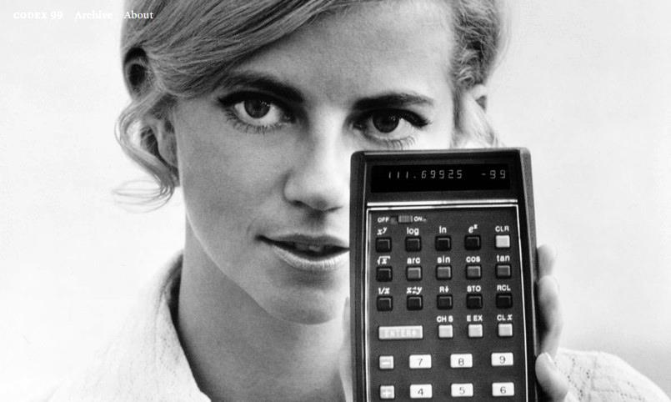
HP-35/ 06
The HP-35 was sold through outlets, shops, mail order, with advertisements in magazines like Esquire, Scientific American etc... Price 2900 current US$. Picture shows HP employee Karen Cambria.

Slide 10
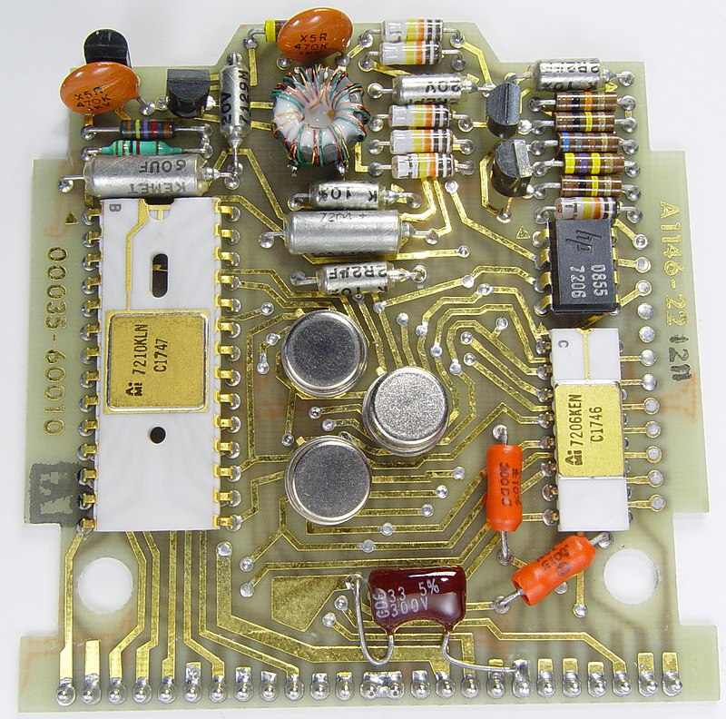
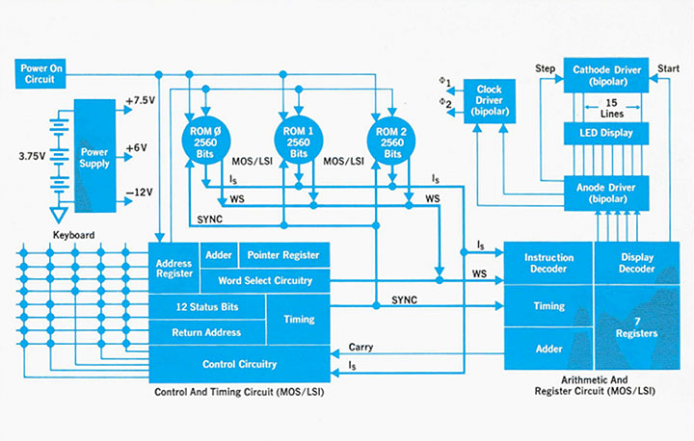
HP-35/ 07a
Inside the HP-35: 5 MOS LSI chips (6000 transistors per chip):
Control & Timing Unit, Arithmetic & Register Unit, 3 ROMS à 2560 bits
Chips manufactured by MOSTEK and AMI.

Slide 11
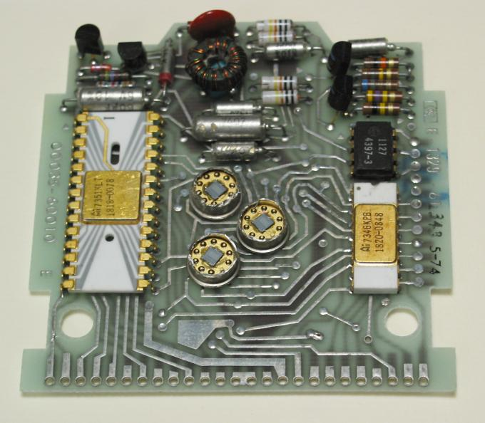
HP-35/ 07b
http://www.pmonta.com/calculators/hp-35/

Slide 12
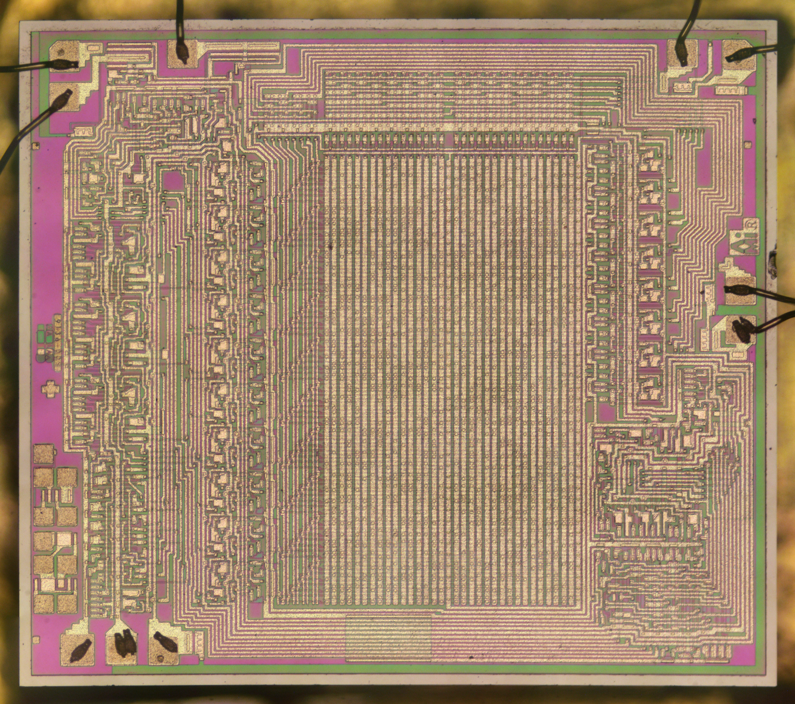
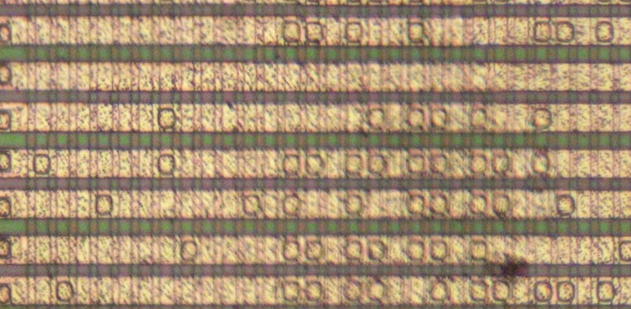
HP-35/ 07c
http://www.pmonta.com/calculators/hp-35/chips/index.html
ROM
Notes:
1974 1 transistor ~10um; today 3nm!!! 3000x smaller

Slide 13
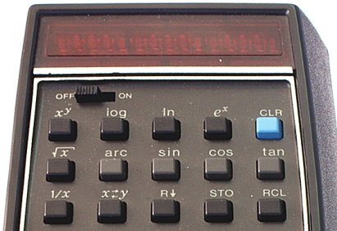
HP-35/ 08
15 LEDS
7 scientific functions
4 stack related keys
… and RPN (Reverse Polish Notation) !

Slide 14
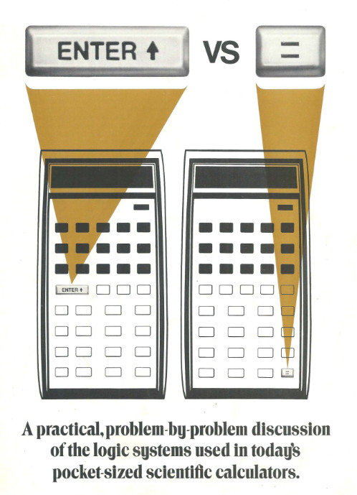
HP-35/ 09a
HP-35 uses RPN = Reverse Polish Notation (Lukasiewicz notation, 1924)
There was some discussion inside HP
if the pocket calculator should use RPN
or bracket-less algebraic notation.
(Algebraic notation with brackets was
introduced with the HP-27s in 1988)

Slide 15
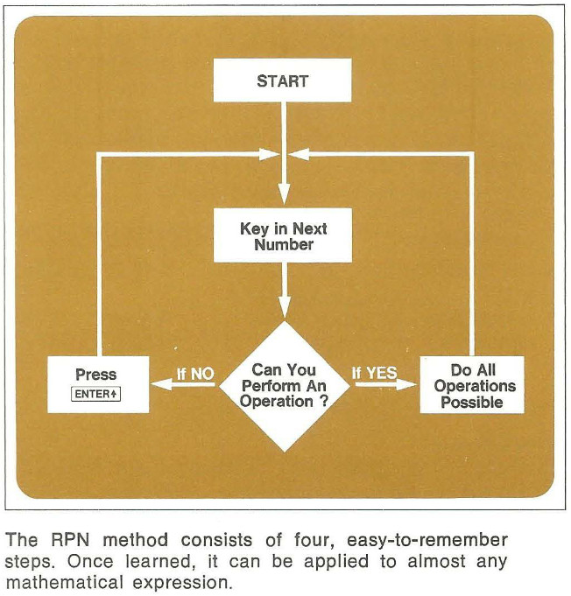
HP-35/ 09b

Slide 16
HP-35/ 09c
RPN is a bracket-less postfix notation where the operator follows the operands:
Ex 1: usual algebraic notation: 3 + 4 = RPN: 3 <Enter> 4 +
Ex 2:
usual algebraic notation: (3 + 4)* (25 – 2) =
RPN: 3 <Enter> 4 +
25 <Enter> 2 –
*
Hewlett-Packard’s RPN requires 4 stacks (= 4 registers) called X,Y, Z,T
(more on these later… )

Slide 17
HP-35/10
Ex 3:
algebraic notation: (12 × 34) + (56 × 78) – (90 × 12) =
RPN: 12 <Enter> 34 x 56 <Enter> 78 x + 90 <Enter> 12 x -
Ex 4:
algebraic notation: 3 x (4 + (5 x (6+7))) =
RPN: 6 <Enter> 7 + begin with innermost 5 x set of parenthesis 4 +
3 x
HP used RPN in all their calculators from the desktop model 9100 on until 1986. Some later calculators offered the choice of algebraic notation or RPN.
Learn using RPN: https://hansklav.home.xs4all.nl/rpn/

Slide 18
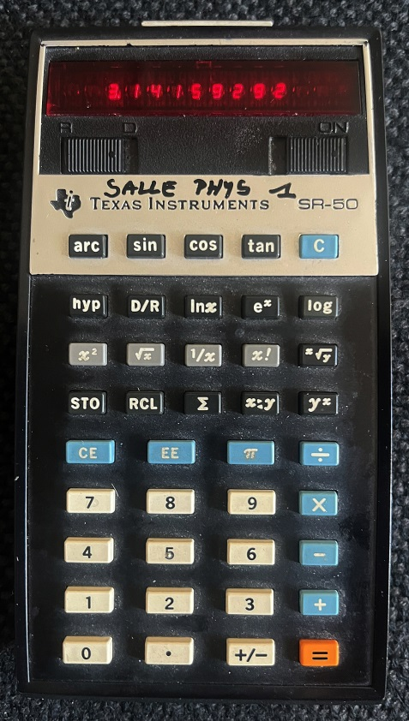
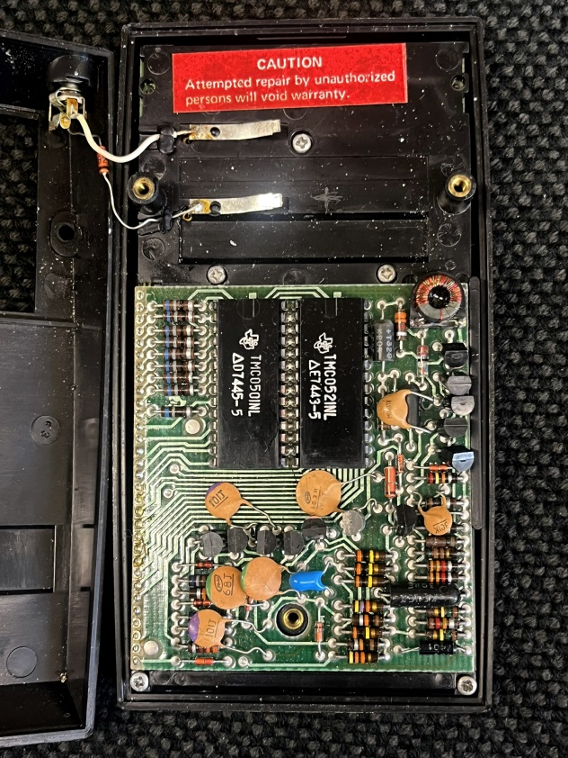
Texas Instruments SR-50
In 1974 (2 years after HP-35), Texas Instruments sold the SR-50;
in Europe the original price of the HP-35 was 2000.- DM (3800.- today Euros),
whereas the SR-50 sold for 520.- DM (942.- today Euros)
Hyperbolic
functions
Algebraic infix notation, no brackets,
use STO RCL
3 registers + M
Only 2 large IC’s
(ALU & ROM)
+ 2 display drivers (on bottom board)

Slide 19
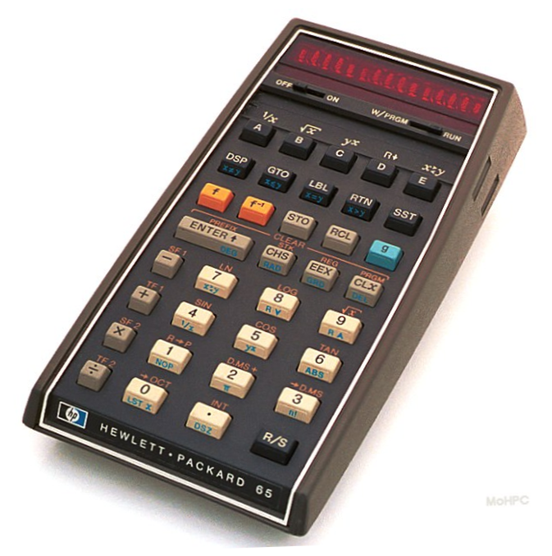
What makes the HP-65 calculator so special?
HP-65/ 01

Slide 20
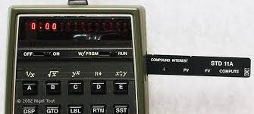
Features:
HP-65/ 02
Everything what the HP-35 can do, plus:
9 user accessible registers (=data memory)
Complex formulas can be programmed, in order to be easily repeatable (comparison tests and jumps included)
Programs (up to 100 steps) can be stored on magnetic cards
Large library of ready-to-use programs (ex. MATH PAC)
High quality didactic user manual and quick reference guide
Program forms ( https://literature.hpcalc.org/community/hp65-forms-en.pdf )
Tutorial videos in color ( https://www.youtube.com/watch?v=f5_hwJnZxXA )
Notes:
The HP-35 stuff could be taken to another slide by Francis
SHOW: loading a program from a card!

Slide 21
HP-65/ 03a
Let’s go back to the year
1974
the year of
Skylab 4

Slide 22
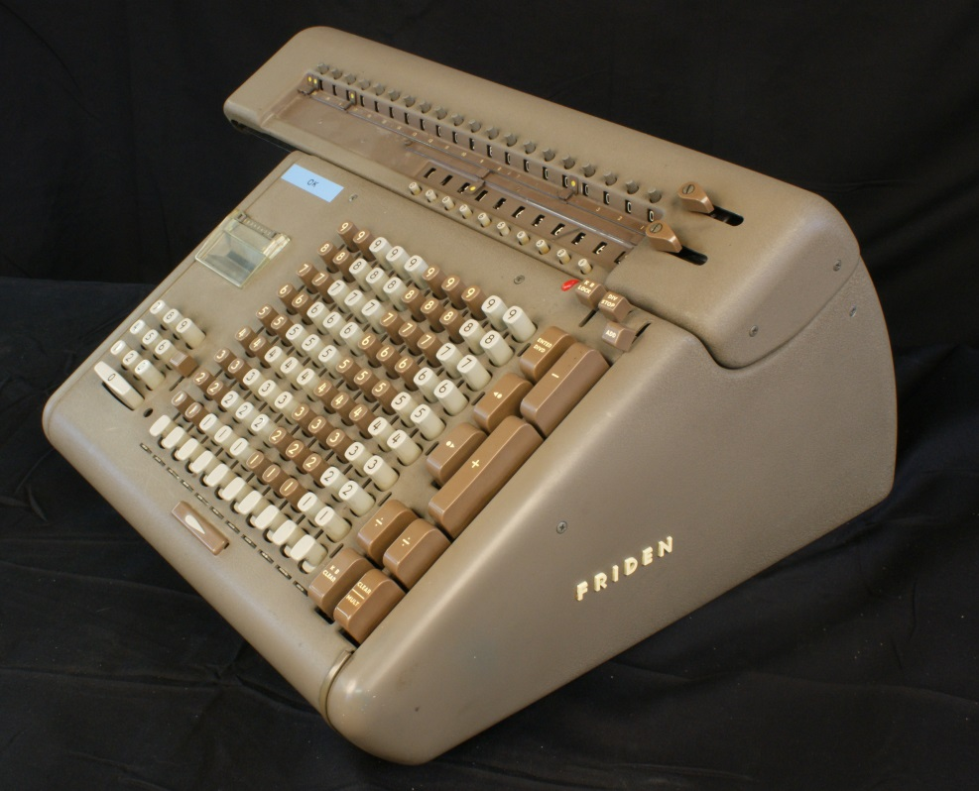
HP-65/ 03b
J. W. Crenshaw, “Math Toolkit for Real-Time Programming”
USA, 2000:
“Once upon a time, in a galaxy far, far away, people didn’t have ready access to computers. They didn’t even have electronic calculators. I was working at NASA in those days. When I needed more accuracy than I could squeeze out of a slide rule, I used an electromechanical calculator --a massive, noisy monster made by Friden…. When there was a Friden in use in the room, everyone knew it. The room lights dimmed, the motor roared, the entire desktop shook…punch-punch-cachunk, punch-punch-cachunk, punch-punch-cachunk-Ding, punch-punch-Ding-clang-clang in a repeated rhythm….”

Slide 23
Friden punch-cachunk (The Apartment, 1960)

Slide 24
HP-65/ 04a
1976: Slide Rule still on High-School Curriculum in Luxembourg (IIIe B)
1978: A few weeks before final exams the Ministry of Education decides:
Scientific calculators are allowed in math and physics
Restriction: no programmable calculator (sic!)
Notes:
Discussion about electronic calculators in schools (1976):
Hand-held calculators would destroy all motivation for learning the basic facts
The use of hand-held calculators would discourage mathematical thinking
cf. https://files.eric.ed.gov/fulltext/ED127206.pdf

Slide 25
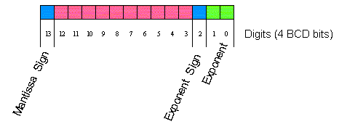
HP-65/ 04b
BCD encoding of the early HP calculators:
https://archived.hpcalc.org/laporte/HP35%20ROM.htm
Arithmetic Unit built upon floating-point +, - and shift operations
$×$10=left shiftor exponent increment
$÷$10=right shift or exponent decrement
https://archived.hpcalc.org/laporte/Floating%20point.htm
COordinateRotation DIgitalComputer (CORDIC) algorithm
for trigonometric and transcendental functions
Jack Volder 1959
J.S. Walther (HP) 1971
https://archived.hpcalc.org/laporte/TheSecretOfTheAlgorithms.htm

Slide 26
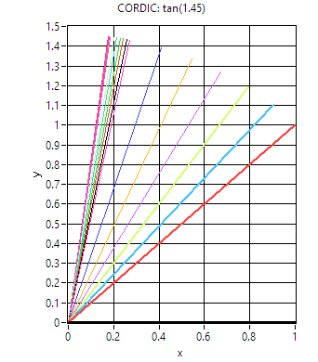
HP-65/ 04c
Trig CORDIC (bcd)
Start
$$θ=angle∈\left[0,\frac{π}{2}\right[$$
$$a\left(i\right)=constant$$
$$i=\left\{0 to n\right\}$$
$$n=precision$$
Angle$θ$
$$a\left(0\right)=\tan^{−1}\left(1\right)=\frac{π}{4}$$
$$a\left(1\right)=\tan^{−1}\left(0.1\right)$$
$$a\left(2\right)=\tan^{−1}\left(0.01\right)$$
…
$$0→ y, i$$
$1 →x$, k
Pseudo-rotation
$$φ=θ−a(i)$$
$$φ>0$$
NO
$$i=i+1$$
$$k={10}^{−i}$$
YES
NO
$$θ=φ$$
$$t=x−ky$$
$$y=y+kx$$
$$x=t$$
$$i>n$$
YES
End
$$\tan\left(θ\right)=y/x$$
$$kx=right shifting x by i digits$$
Notes:
Can easily be extended to inverse trig functions and transcendental functions.

Slide 27
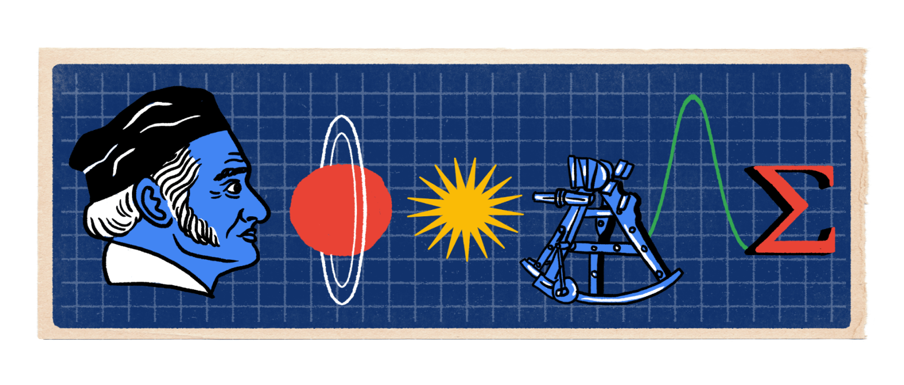
HP-65/ 05
Let’s take a typical question:
solve: $a\sin{x}+b=0,with a≠0$
$⇒sinx=−\frac{b}{a}, condition −1≤−\frac{b}{a}≤1$
$⇒x=\arcsin\left(−\frac{b}{a}\right)+2kπ or x=\left(2k+1\right)π−arcsin\left(−\frac{b}{a}\right)$
Notes:
You guessed it: every scientist and engineer needs an HP-65!

Slide 28
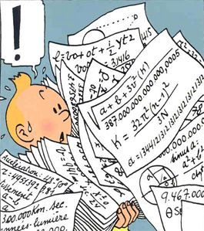
HP-65/ 06
Why would one need a HP-65
at US$ 795.- (today US$ 4912.-)
to solve a*sin(x)+ b = 0 ?
Notes:
Luxembourgish anecdote to the typical student question, when being plagued with trigonometry: Why would you need that d… sine? Op d’Fro, wien de Sinus dann eigentlech brauch, huet de Spielmann’s Tit gesot: “Nët, nët, fir deen, deen de Sinus nët brauch, spillt et keng Roll, op et Trigonometrie gëtt oder nët. Deen, deen de Sinus brauch ass frouh, datt et e gëtt.”) So, the HP sales management must have found a similar answer to the important question, who needs the HP-65 calculator. Engineers and scientists will be happy to become HP-65 customers, because they know that they absolutely need it.

Slide 29
HP-65 program solving$asinx+b=0$
HP-65/ 07
1 LBL
2 A
3 g
4 rad
5 R/S
6 /
7 CHS
8 ENTER
9 g
10 abs
11 1
12 g
13 x<>y
14 g
15 x<=y
16 GTO
17 1
18 5
19 5
20 5
21 R/S
22 LBL
23 1
24 R v
25 R v
26 f-1
27 sin
28 RTN
Key: b A a R/S
a | b | x
2 | 0 | 0
2 | -0,25 | 0,12532783
2 | -0,5 | 0,25268026
2 | -0,75 | 0,38439677
2 | -1 | 0,52359878
2 | -1,25 | 0,67513153
2 | -1,5 | 0,84806208
2 | -1,75 | 1,06543582
2 | -2 | 1,57079633
2 | -2,25 | ERR
Single
Calculation: g RAD
b ENTER
a divide CHS f⁻¹ sin
Notes:
Enter program, run an example. Then show program steps by SST in PRGM mode. Show card loading (Don’t forget RUN mode.)
Picture has been made with ChatGPT.
Comparasion: if «FALSE» →skip next 2 steps (Owner Handbook p.63) add pictures of keys A, R/S **** Francis: what is step 8 ? ENTER^ ****

Slide 30
HP-65/ 08
HP offered a 15 days trial for customers to discover that they absolutely need to buy it.

Slide 31
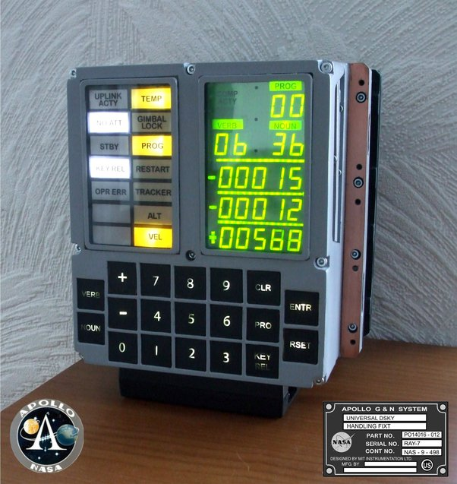
HP-65/ 08a
Some famous achievements:
1975 : HP-65 in space with Apollo-Soyuz.
The American astronauts calculated critical course-correction maneuvers
on their HP-65 programmable hand-held during the rendezvous of the
U.S. and Russian spacecraft.
The HP-65 was the backup for the Apollo Guidance Computer.
User interface of the AGC:

Slide 32
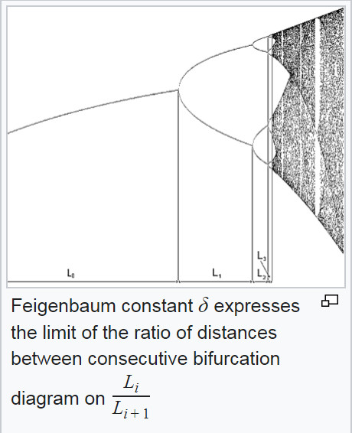
HP-65/ 08b
Another famous achievements by Mitchell J. Feigenbaum, using the HP-65 at the Los Alamos National Laboratory:
1975 : Discovery of the Feigenbaum Constant (chaos theory)
delta = 4.6692

Slide 33
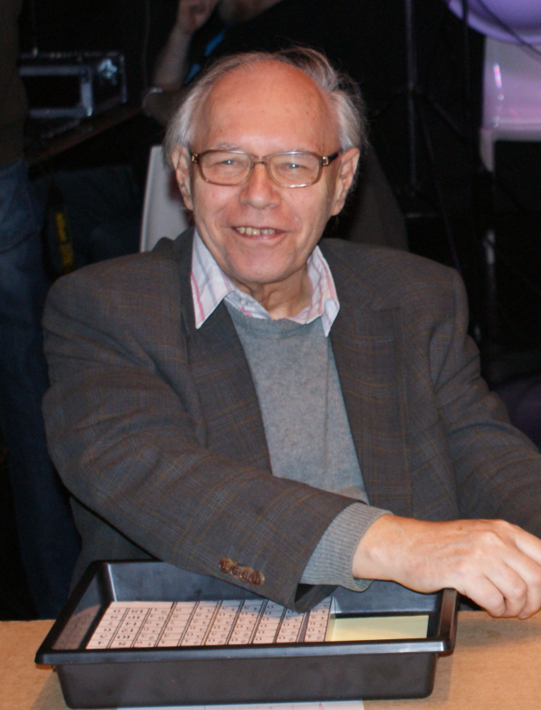
HP-65/ 09
Prof. Jean Mootz (1931-2013)
Luxembourgish pioneer owner of a HP-65 calculator (1975)
He gave high-school students the opportunity to play with it
➔ This WAS exceptional !

Slide 34
HP-65/ 10
We mean “play” literally!
In fact, Mr. Mootz somehow unearthed “65 notes”, the journal of the HP-65 Users Club (US).
Specialty of this journal:
hints, tips, shared programs, games, background information, internals, and…
well, in 1974, the substantive “hacker” was not coined yet…
And THIS was really exceptional !!!
The students could play with:
Undocumented behaviors
Tricks
Crashes
Notes:
In fact, this was playing with the microcode behind the scene. NOTE: all these hack examples here are very short. So, their presentations last only for a few moments, each.

Slide 35
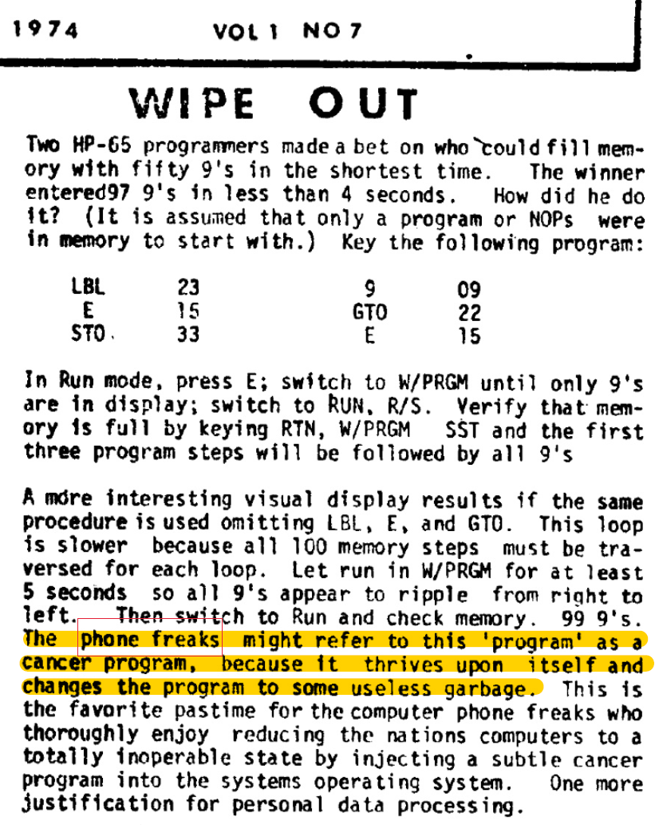
Hack 1a 1b
HP-65/ 11
LBL E
STO
9
GTO
E
RUN
E
W/PRGM
RUN R/S
W/PRGM
SST
9’s in
Program
memory
Notes:
In fact, this was playing with the microcode behind the scene. NOTE: all these hack examples here are very short. So, their presentations last only for a few moments, each.
Codes: row, colum; there are merged codes

Slide 36
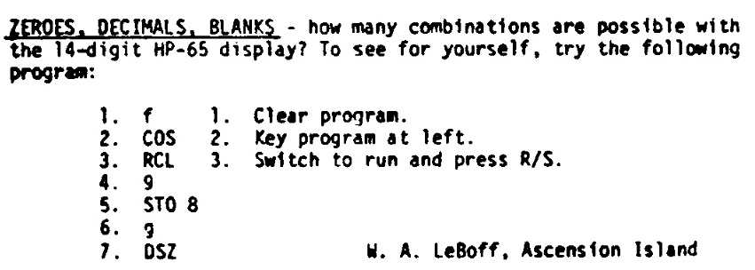
Hack 2
HP-65/ 12
Display mystery
f
cos
RCL
9
STO
8
g
DSZ
Notes:
If we type this sequence, the display will show ever changing locations of zeroes and dots.

Slide 37
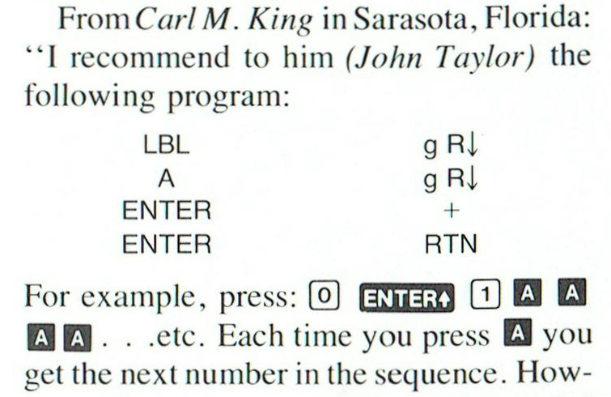
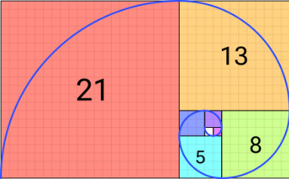
Super short cool programming!
HP-65/ 13a
Fibonacci sequence:
F(0) = 0 F(1) = 1 …. F(n) = F(n-2) + F(n-1)
8 code lines only!
(from 65notes v1n5)

Slide 38
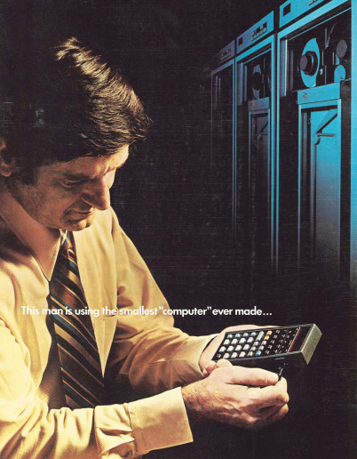
HP-65/ 13b
A resounding success story!
Sold at 795.- US$ (~4900 US$ today)

Slide 39
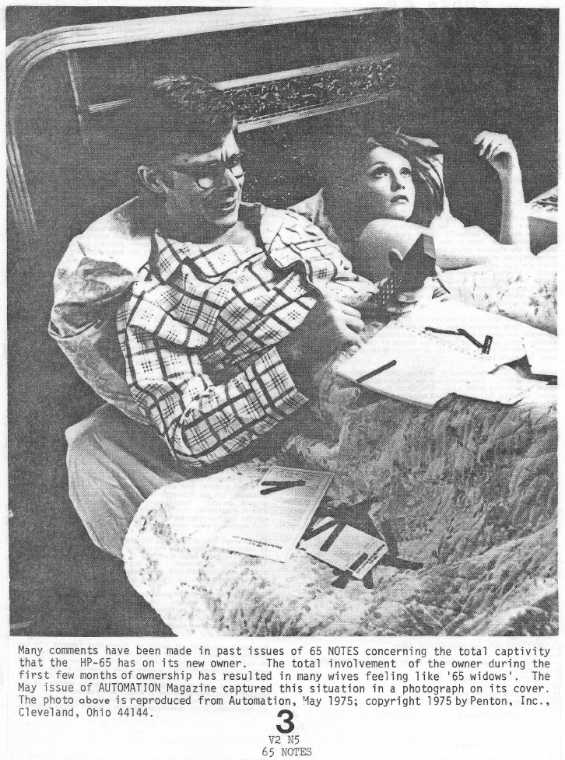
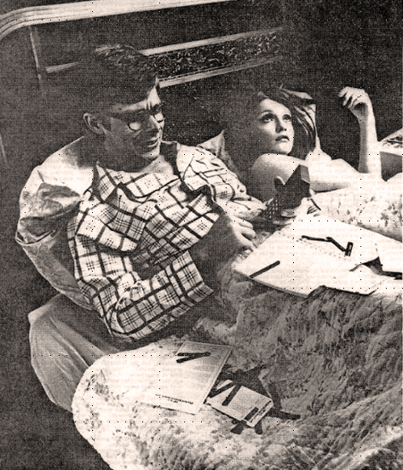
HP-65/ 13c
A truly addictive device, with a totally captive owner !
“The one who really needs a HP-65”
and his 65 widow !

Slide 40
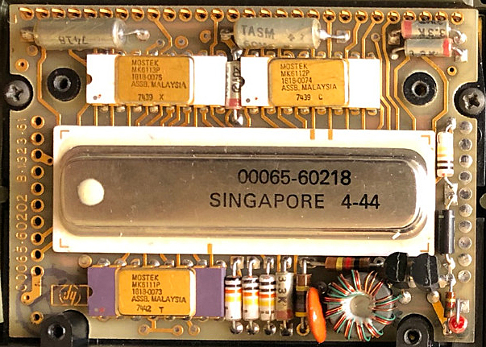
HP-65/ 14a Internals 1
Main board of J. Mootz’s HP-65 (there are 2 other boards inside)
ROM
ROM
Hybrid Chip with: ALU & Registers (10 à 56 bit)
Control & Timing (178 kHz)
Dual Ram
Clock driver & Init
Card Reader Ctrl.
All ROM: 3k 10-bit words
ROM

Slide 41
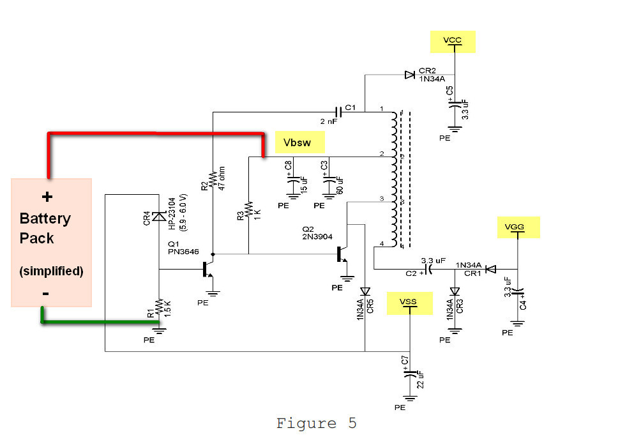
HP-65/ 14b Internals 2
The HP-65 needs 3 different DC voltages,
which are derived from the battery package
of 3 NiCd AA cells in series (3.6 V)
Vcc = 8.2 V Vgg = -12.4 V Vss = 6.28 V
(John Robinson HP65 Diagnosis and Repair)

Slide 42
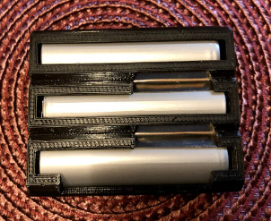
HP-65/ 15a The HP-65 today
Today, many of the HP-65 are 50 years old…
Usually they aged quite well with the two exceptions:
The battery pack is definitively defunct. It is relatively easy to replace the old NiCd AA batteries with new ones, or to buy a reconstruction build with a 3D-printer
Ebay.de ca. 28.-€
Never use the HP-65 without
the battery (even defunct) in place!

Slide 43
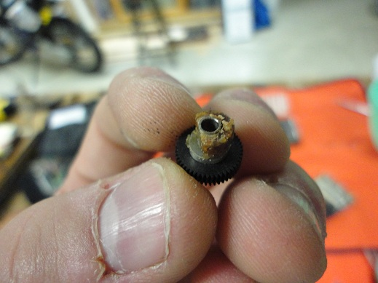
HP-65/ 15b The HP-65 today
2. The magnetic card reader does not work anymore.
This is the case for practically all existing HP-65s.
With good luck you may read a card one or two times, before disaster strikes!
The culprit: several plastic pieces (like roller wheel) have crumbled or changed to a smeary goo.
Roller wheel which drives magnetic
card has crumbled away.
No replacement pieces exist, so
this repair is very demanding
and difficult!
(www.hpmusueum.org)

Slide 44
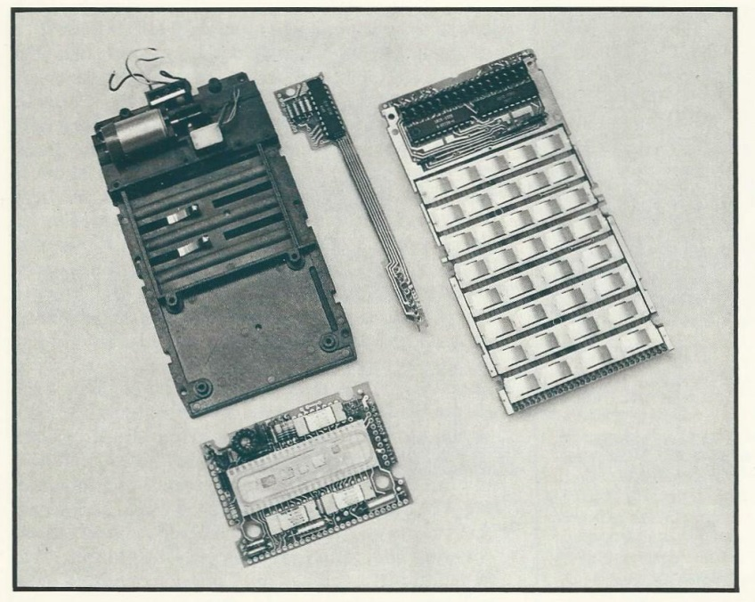
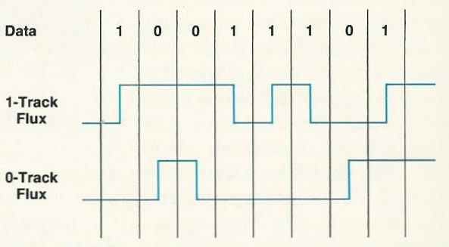
Repair/ 01 Magnetic card reader
The magnetic card reader is a 1974 innovation.
Swiss motor 1.5cm 10000rpm 180mA
Worm gear→ Card speed: 3.75-6.5 cm/s
Polyurethan rubber
400bit/inch→ head alignment at +/-0.25°
2 tracks
Geometry tolerance +/-0.001inch=0.0254mm
Special plastic
Notes:
From HP Journal May 1974

Slide 45
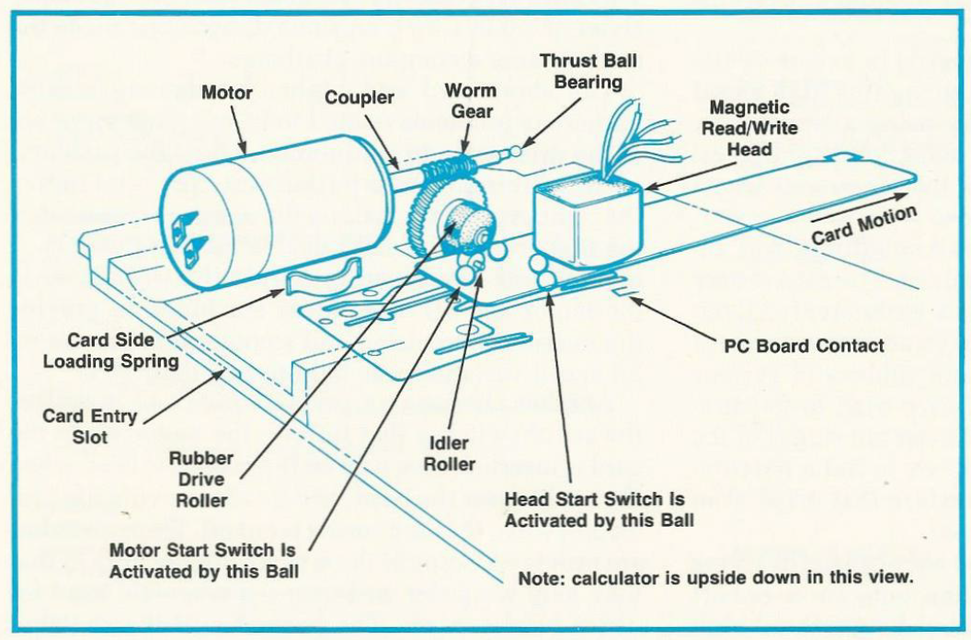
Repair/ 02 Magnetic card reader
Notes:
From HP Journal May 1974

Slide 46
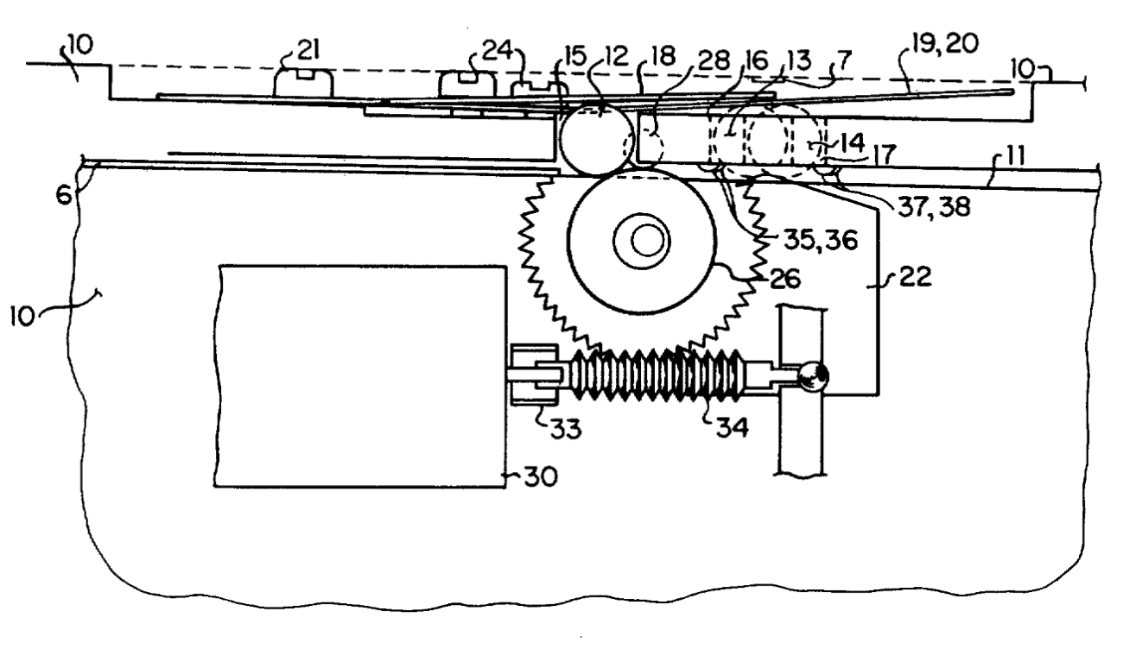
Repair/ 03 Magnetic card reader
1975 US patent 3,893,173
Notes:
From HP Journal May 1974

Slide 47
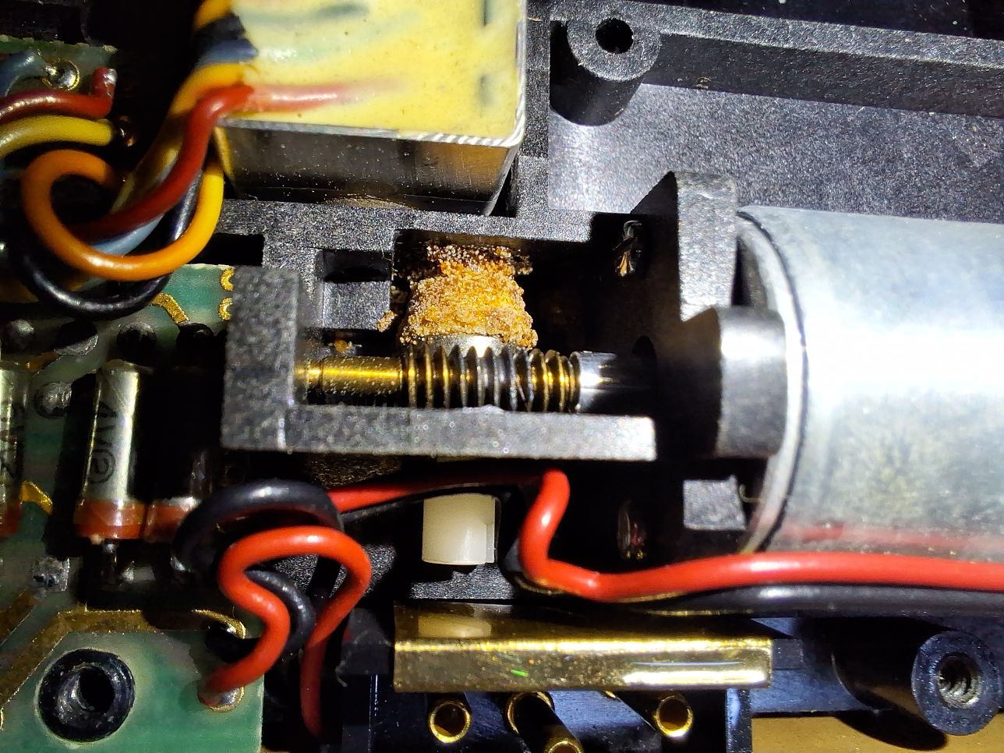
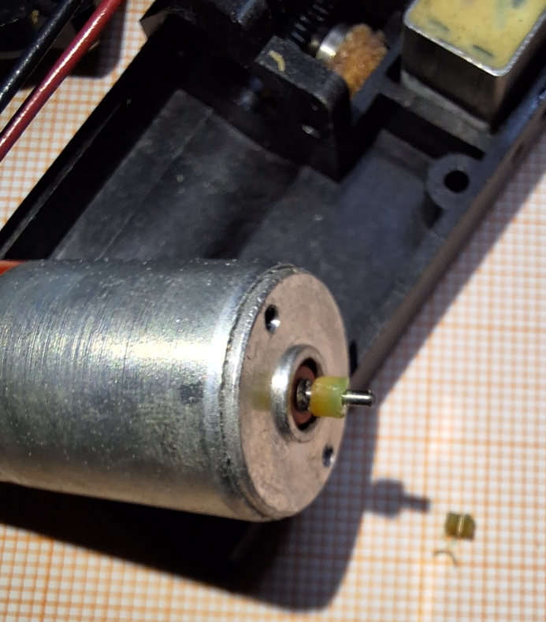
Repair/ 04 Magnetic card reader
2024
Roller wheel crumbled to pieces!

Slide 48
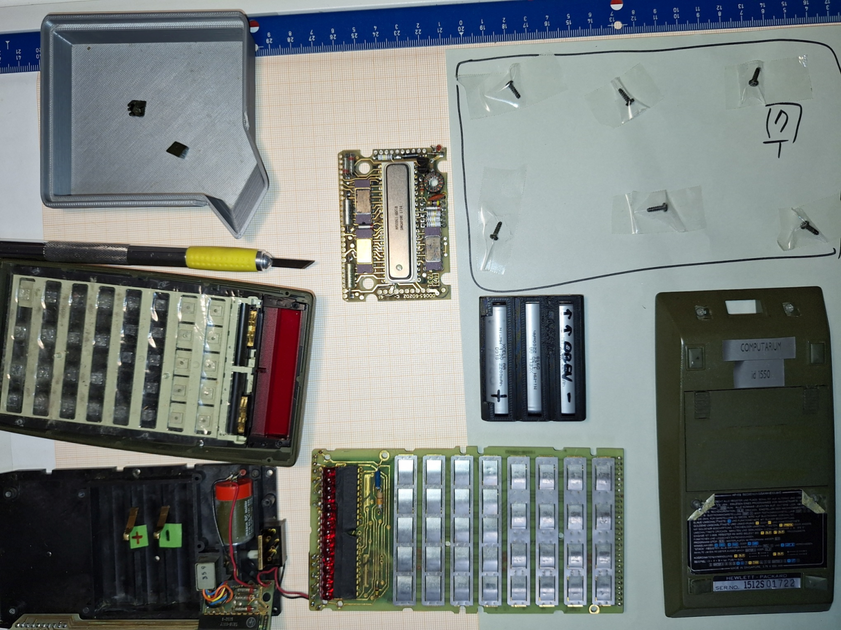
Repair/ 05 Fix procedure 1

Slide 49
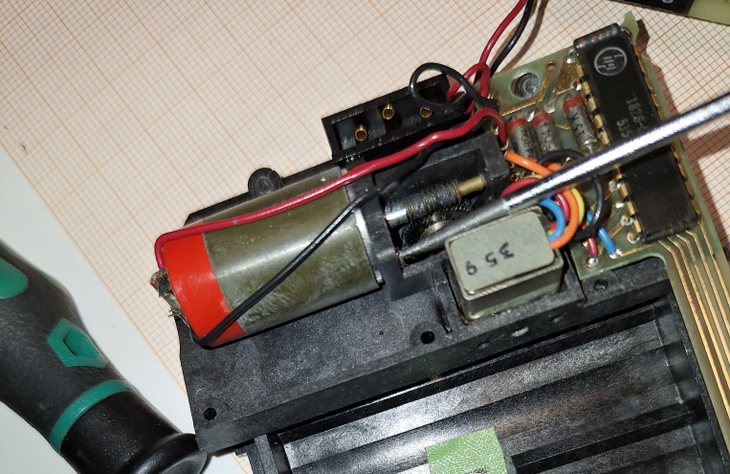
Repair/ 06 Fix procedure 2
Here the worm-screw is smeared with black goo

Slide 50
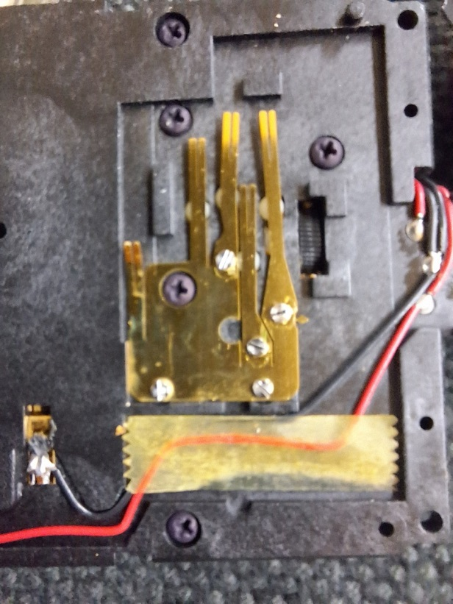
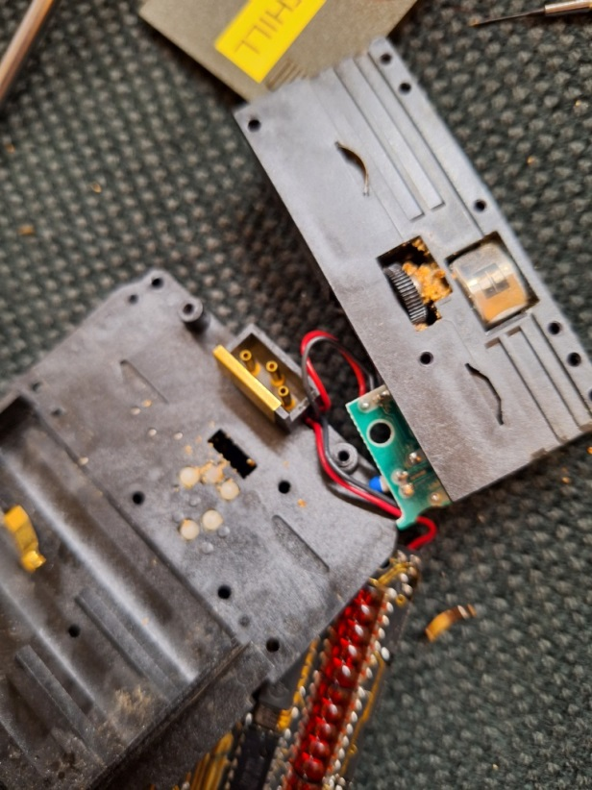
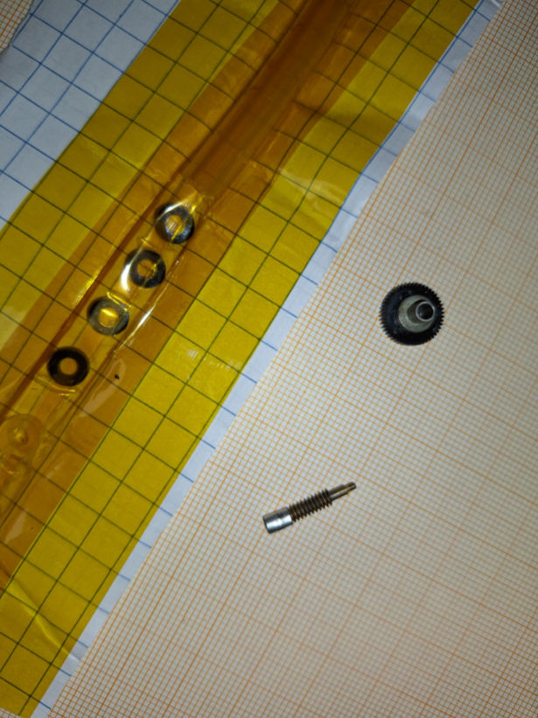
Repair/ 07 Fix procedure 3
Toothed wheel driven by worm screw
with roller crumbled away
Switching contacts
with tiny plastic balls
beneath.
Magnetic read/write
head
Replacement rollers

Slide 51
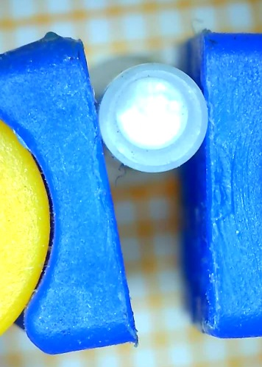
Repair/ 08 Fix procedure 4
Axis holding the plastic roller
Ball at the tip of the axis,
slightly eccentric.

Slide 52
Repair/ 09 Fix procedure 5
Clutch repair: two stacked silicone wire insulations of the appropriate size
Notes:
Explain «slip clutch» in the case of stalled motor. Also, reduces vibrations.

Slide 53
Repair/ 10 Fix procedure 6
Logic Analyzer
https://www.hpmuseum.org/cgi-sys/cgiwrap/hpmuseum/articles.cgi?read=389
https://www.hpcc.org/cdroms/schematics5.0/handhelds/classic/hp65.pdf
https://www.teenix.org/ (replacement board fitted in Jean Mootz HP-65)
Notes:
Measuring the signals.

Slide 54
Repair/ 11 Fix procedure 7
Timing issue
https://archived.hpcalc.org/museumforum/thread-75965.html
Notes:
From Forum (75965) Dear fellow HP aficionados:
Some people owning old HP65/67/97 have reported difficulty with card reader speed adjustment, especially after mounting a new friction wheel. As my previous post on the topic did not yield any useful information on how to do it, I worked out a procedure that does not need a priori knowledge of any factory adjustment parameters:
The proposition is that HP orginal cards were written with in-spec bit density and did not change over the ~30 years. Just as you would expect from a top-quality manufacturer. (Hopefully so !)
So if we have a means to compare bit density on an original card with its copy written on a HP65/67/97, then the motor speed of the latter can be adjusted to yield the same bit density as was on the original HP card.
As a means to compare bit density we use another HP65/67/97 (not the one to be adjusted) with good card drive (not worn) but the speed of this one does not matter (may be a bit off) as long as it does not change much between reads, which can be verified by applying simple statistics on the measurements.
Bernies' procedure: put a digital sampling oscilloscope or a 30ms retriggerable monoflop followed by a digital timer / counter (I used a HP 5327A, has nice Nixie Tubes) on one of the two read lines coming from the card reader amplifier chip of the HP65/67/97 to be used as a measurement tool.
Set up to measure the total time interval from the first read pulse to the last read pulse. Run original HP card through for a few times (i.e. 20 times). Note the time intervals. Use a HP calculator to get mean and standard deviation. In my case, I got mean = 1110,6 milliseconds with a standard deviation sd = 4.4 ms. Beware: other cards / calculators may give different results.
3 * sd / mean is a indication of the accuracy you can achieve with this improvised measurement setup - in this case, about 1.2% accuracy with nearly full confidence, enough for the purpose.
The mean is the value you want to get from a card written on the HP to be adjusted. Then you have identical bit density on the original HP card and its copy.
Now the repeat loop for speed check / adjustment:
Copy the original HP card on the HP to be adjusted. Run the copy through the measurement HP. Compare the time interval of the copy with the mean "reference" time interval taken from the original HP card.
If the copy gives higher readings, bit density is too low, speed must be increased, and vice versa. After each speed adjustment, make a new copy to get the new bit density and repeat the measurement.
Replacing the original speed setting resistor of the HP to be adjusted with a trimpot / resistor combination is helpful, but only needed if speed needs be corrected, so don't solder before you have the first result. Some well - known tricks as marking the previous settings on the pot or measuring and noting the resistance before and during adjustment will help to quickly zero in to the final setting, on which both cards (original and copy) will yield the same time interval, and hence, will have the same bit density.
The beauty of this scheme is that no reference other than the original HP card (standard pac) is needed. The measurement HP can be adjusted afterwards by interchangig roles. One final hint: checking the measurement HP with the original card now and then will give confidence during the adjustment procedure. If the "reference" time interval starts to deviate, the motor speed of the measurement HP is not very stable (weak battery?) but the adjustment procedure can continue with targeting the new "reference" time interval. Always do the statistics to be sure to have reliable results.
I have tested the above on three HP67s, and all now work fine. One of them has a trimpot already installed (original HP ?) and someone had played with it. This unknown guy has forced me to think out the above procedure.
Comments / success stories invited !
Regards, Bernhard

Slide 55
Python compiler/ 01
As our current students usually are fluent in the Python programming language
a cross-compiler was developed by Claude Baumann to translate
a subset of Python code ( named “Lilli-Python”) into HP-65 instructions.
Programming was made in LABVIEW, and work finished in March 2024 (see https://computarium.lcd.lu/news.html)
We know of no comparable software in existence.
Notes:
Stack depth 4 is sufficient for most operations.

Slide 56
Python compiler/ 01a
Exercise1: calculate $y=\sin\left(0.25\sqrt{π}−7/ln\left(3\right)\right)$
HP-20S: .25 x >π – 7 / 3 LN = SIN → 0.34724
HP-35/65: .25 gπf x 7 ENTER^ 3 fLN / –fSIN→ 0.34724
STACK:
x | y | z | t | Operation
0.25 | 0.00 | 0.00 | 0.00 | 0.25
3.141592653 | 0.25 | 0.00 | 0.00 | g pi
1.772453851 | 0.25 | 0.00 | 0.00 | f sqrt
0.443113463 | 0.00 | 0.00 | 0.00 | x
7.00 | 0.443113463 | 0.00 | 0.00 | 7 ENTER^
1.098612289 | 7.00 | 0.443113463 | 0.00 | 3 f LN
6.371674584 | 0.443113463 | 0.00 | 0.00 | /
-5.928561121 | 0.00 | 0.00 | 0.00 | -
0.347237054 | 0.00 | 0.00 | 0.00 | f SIN
Notes:
Stack depth 4 is sufficient for most operations.

Slide 57
Python compiler/ 01b
Exercise1: calculate $y=\sin\left(0.25\sqrt{π}−7/ln\left(3\right)\right)$
Python expression: print( sin(0.25*sqrt(pi) – 7/log(3)) )
Notes:
Show screen for this evaluation

Slide 58
Python compiler/ 02
Exercise 2: calculate
HP-67/65:
Not evident at all to find that procedure from such a complex formula:
HP RPN algorithm (Slide HP-35/09b) FAILS here!
STACK OVERFLOW (too many ENTERs)
Equation broken into parts
Notes:
Formula taken from HP-67 Owner’s Handbook p.106
Difference to HP-65: no g x^2 function, so use instead: ENTER x

Slide 59
Python compiler/ 02b
→ Not evident at all to find that procedure from such a complex formula
Notes:
Formula taken from HP-67 Owner’s Handbook p.106
Difference to HP-65: no g x^2 function, so use instead: ENTER x

Slide 60
Python compiler/ 03
Notes:
Thank you Wolfram!

Slide 61
Python compiler/ 04 long formulas
M = sqrt(5*(pow((pow(1+.2*pow(350/661.5,2),3.5)-1)*pow(1-6.875E-6*25500,-5.2656)+1,.286)-1))
Notes:
We created Lillipython for the purpose. Lillipython uses software stack extension!

Slide 62
Python compiler/ 05 iterations
Exercise3: calculate $\sqrt{i}$ for i= 0..99
PYTHON:
for i in range (100): print(sqrt(i))
1 0
2 STO 1
3 LBL
4 1
5 RCL 1
6 1
7 0
8 0
9 g x=y
10 GTO
11 2
12 RCL 1
13 f
14 SQRT
15 R/S
16 1
17 STO
18 +
19 1
20 GTO
21 1
22 LBL
23 2
24 RTN

Slide 63
Python compiler/ 06 conditions
Exercise4: calculate the roots of $ax^{2}+bx+c$=0
PYTHON:
def A():
a=input(); b=input(); c=input()
delta=b*b-4*a*c
if delta>=0:
q=sqrt(delta)
print((-b+q)/2/a)
print((-b-q)/2/a)
else: print(1/0)

Slide 64
EMULATORS/1
HP-35: hp35emulator.zip (Windows)
http://www.panamatik.de/html/hp_classic.html
IOS (iPhone): RPN-35 SD (1.99 €) * https://www.cuveesoft.ch/rpn35/
TI SR-50: SR50.EXE (Windows) http://www.datamath.org/Display/commemoratives/SR50/SR50.exe
______________________________________________________________
HP-65:
Windows: hp65emulator.zip (Windows)
http://www.panamatik.de/html/hp_classic.html
HP65.zip
https://www.teenix.org/
* The cuveesoft emulators also run on several Mac and iPads
Notes:
We created Lillipython for the purpose.

Slide 65
EMULATORS/2
IOS (iPhone): RPN-65 SD (2.99 €) (full magnetic card library incl.)
https://www.cuveesoft.ch/rpn65/
Notes:
We created Lillipython for the purpose.

Slide 66
EMULATORS/3 RPN-65 SD
Notes:
We created Lillipython for the purpose.

Slide 67
EMULATORS/4 RPN-65 SD
Notes:
We created Lillipython for the purpose.

Slide 68
LINKS
http://www.codex99.com/design/the-hp35.html
The HP-35 story, by John Minck (excellent histories of HP-35)
https://www.hpmuseum.org/hp65.htm
(excellent history of HP-65)
http://hparchive.com/Journals/HPJ-1974-05.pdf
(first original articles by the developers of HP-65)
https://literature.hpcalc.org/community/hp65-pac-standard-en.pdf
(manual of the standard software PAC delivered with a new HP-65)
http://home.comcen.com.au/therobinsons/hpcalcs/hp65/hp65repair.pdf
https://www.hpmuseum.org/cgi-sys/cgiwrap/hpmuseum/archv021.cgi?read=237065
(repair and restoration)
https://www.teenix.org
(replacement boards, schematics, MultiCalc emulator….)
http://www.pahhc.org/ppccdrom.htm
(PPC archive, huge collection of 76000 pages on USB stick, 25+18 US$)
The Calculator Store
(Spanish store which repair offers for HP calculators)
Notes:
We created Lillipython for the purpose.

Slide 69
Merci fir d’Nolauschteren!
Slides sinn op: https://computarium.lcd.lu/works/HP65_anniversary.pptx
https://computarium.lcd.lu/literature/COMPUTARIUM_CREW/

